Slide 2

Introduction to Spread Sheets
What is Spreadsheet?
An arrangement of cells in columns and rows used to organize, analyze, calculate, and report information, usually in numerical form.

Slide 3
Introduction to Spread Sheets
What is Workbook?
A file which contains one or more spreadsheets.

Slide 4

Excel Getting Started

Slide 5
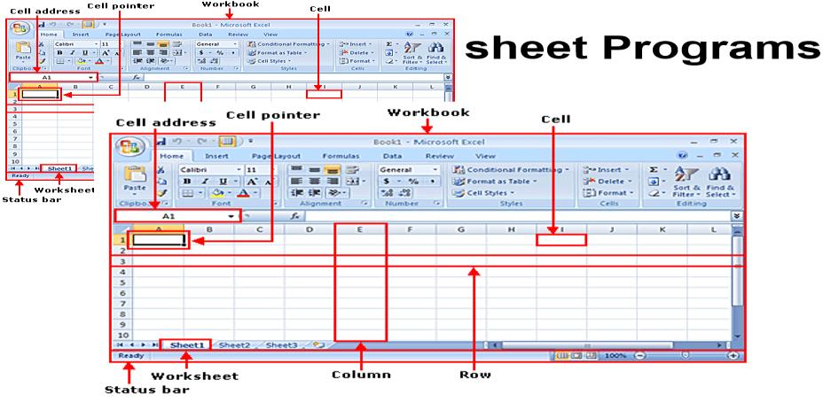
Spread Sheet

Slide 6
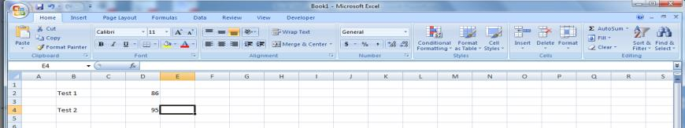
Working in a Spread sheet
To work with a spreadsheet, you enter data in the cells of the spreadsheet.
You enter data by clicking a cell and typing the data.
To replace data in a cell, you click the specific cell and type the new data.
To edit data in a cell, you double click in the cell and type additional data.
Note: when editing data, a blinking cursor appears.

Slide 7
Working in a spreadsheet (cont.)
You can enter three types of data in a spreadsheet:
Text: Text data has no numeric value associated with it.
Numbers: A number has a constant numeric value, such as the test scores attained by a student.
Formulas and functions: Formulas and functions are mathematical equations.

Slide 8
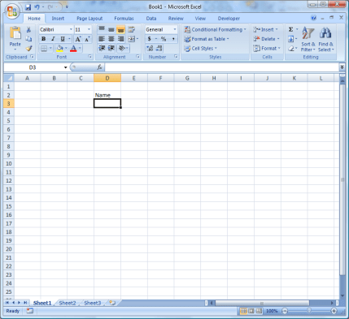
Working in a spreadsheet (cont.)
To ENTER data:
click on the cell
type information
press ENTER.
The data can be both number and text.

Slide 9
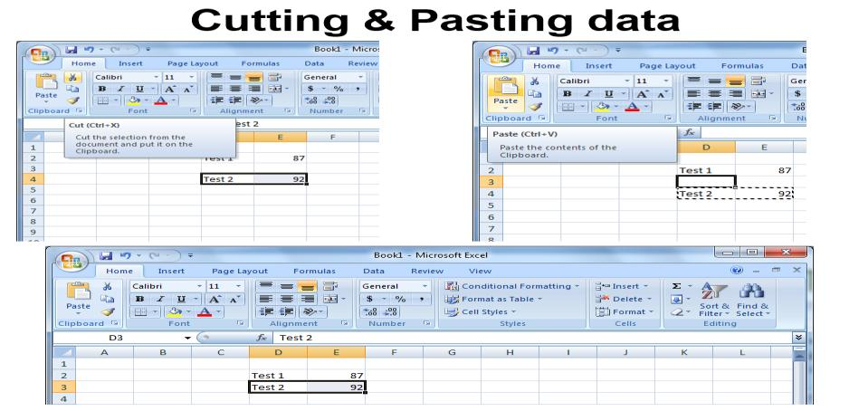
Working in a spreadsheet (cont.)

Slide 10
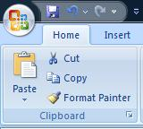
Cutting & Pasting data (cont.)
To COPY contents of a cell:
Click on the cell,
Select the Home tab,
Click Copy from the Clipboard Group.
To PASTE contents of a cell:
click on the cell,
Select the Home tab,
click Paste from the Clipboard Group.

Slide 11
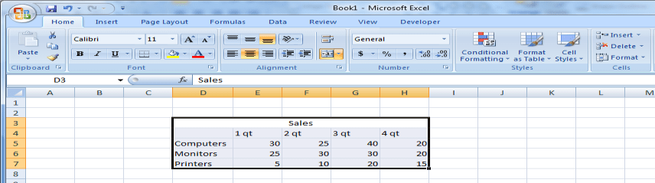
Selecting cells
To select a range of cells in a column/row, click the left mouse button in a cell & drag the mouse pointer to highlight the cells of your choice.

Slide 12
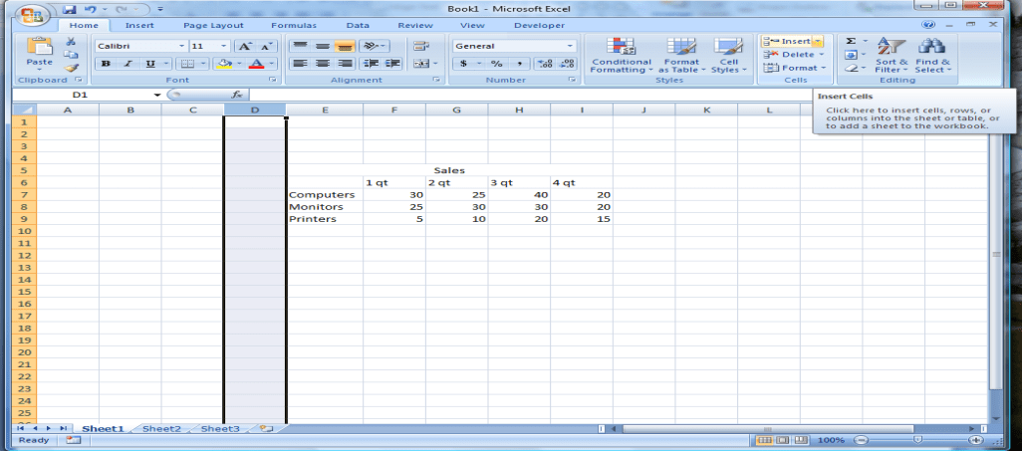
Adding rows & columns
To INSERT a Row/Column:
Select the row/column heading,
Click the Home Tab,
Click the Insert button from the Cells Group.
The insertion occurs before the selected column/row.

Slide 13
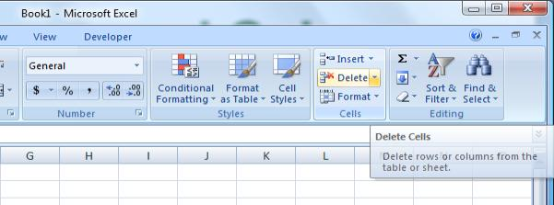
Deleting Rows and Columns
To delete a column/row:
click the column/row heading
click the Delete button on the Cells Group of the Home Ribbon.

Slide 14
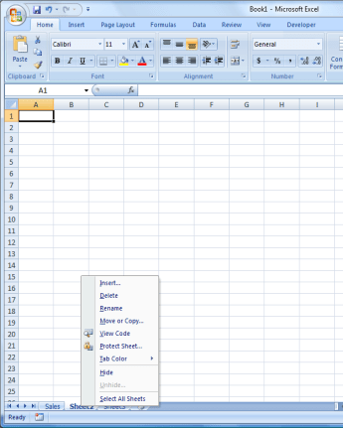
Editing spreadsheets
To rename a worksheet:
double-click the sheet tab
type the new name
press ENTER
You can also Delete & Insert a Worksheet as well.

Slide 15
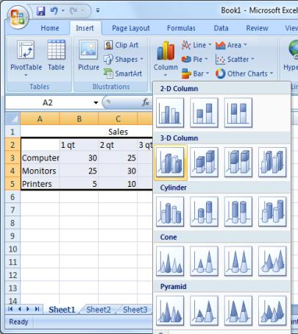
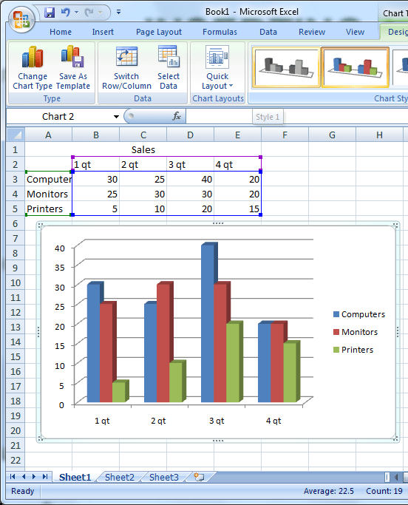
Inserting a chart
Formulas & functions

Slide 16

Formulas & functions
Excel reads any expression that begins with an equal sign as a calculation.
All functions and formulas begin with an equal sign.
The function =SUM(B1:B6)
The formula =B1+B2+B3+B4+B5+B6

Slide 17
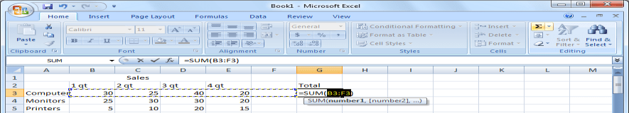
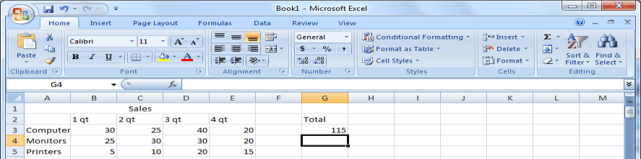
Formulas & Functions
Inserting a function
To Calculate the Sum of cells , click the destination cell, select the SUM button (sigma symbol), select cells for which you want to calculate the sum, drag the mouse pointer from cell C3 to cell C6, and then press ENTER.

Slide 18
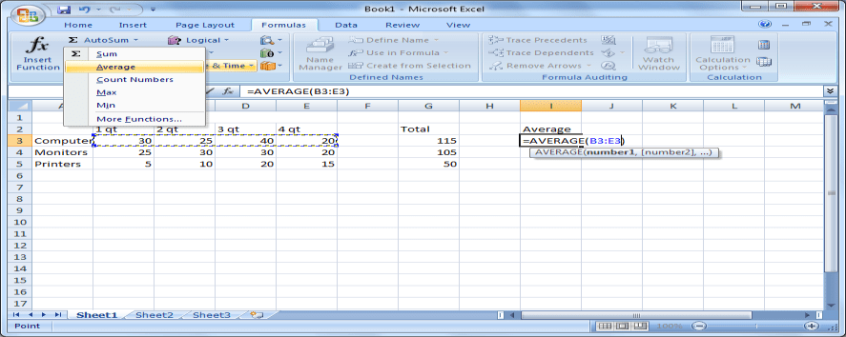
Inserting a function
Inserting a function
Excel also provides a list of predefined formulas called functions. To insert a function to calculate the average of a group of values, click the Insert menu, and then click Function (2)To specify which cells should be used to calculate the average, in the Function Arguments dialog box, press SPACEBAR to have the cell range typed for you in the Number1 box, and then click OK. (3.) To save time, you can use the AutoSum button to perform functions such as sum and average

Slide 19
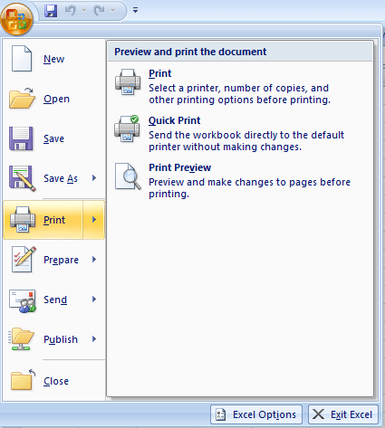
How to Print Spreadsheet Data
To print a spreadsheet, click the Microsoft Office Button, point to Print, and then click Print.
Inserting a function

Slide 20
How to Print Spreadsheet Data
To print a spreadsheet, click the Microsoft Office Button, point to Print, and then click Print.
Inserting a function

Slide 21
Manipulation of Excel Data
Inserting a function

Slide 22
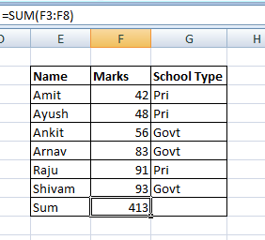

Software process and Process Models
Sum : MS Excel
Sum()
It is the summation all values in any particular row or column
Select any particular block where sum will be store
Write the formula for sum () in the formula bar
=SUM(first column/row : last column/row)
In this example it is –
SUM(F3:F8) and result is in block F9
Program Name: B.Tech –CSE
22

Slide 23
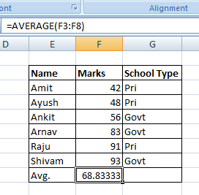
Software process and Process Models
Average : MS Excel
Average()
It is the average of all values in any particular row or column
Select any particular block where the average will be store
Write the formula for average () in the formula bar
=AVERAGE(first block column/row : last block column/row)
In this example it is –
AVERAGE(F3:F8) and result is in block F9
23

Slide 24
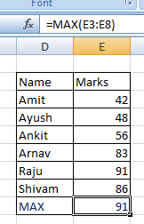
Max: MS Excel
MAX()
It will return the maximum value among all the values in any particular row or column
Select any particular block where the average will be store
Write the formula for MAX () in the formula bar
=MAX(first block column/row : last block column/row)
In this example it is –
MAX(E3:E8) and result is in block E9

Slide 25
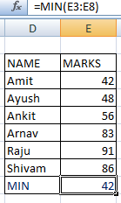
Min: MS Excel
MIN()
It will return the minimum value among all the values in any selected particular row or column
Select any particular block where the average will be store
Write the formula for MIN () in the formula bar
=MIN(first block column/row : last block column/row)
In this example it is –
MIN(E3:E8) and result is in block E9

Slide 26
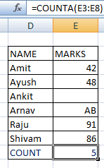
Count: MS Excel
COUNT()
It will return the count the total number of numerical values among all the values selected in any particular row or column
It will exclude the blank cell
Select any particular cell where the average will be store
Write the formula for COUNT () in the formula bar
=COUNT(first cell column/row : last cell column/row)
In this example it is –
COUNT(E3:E8) and result is in cell E9

Slide 27
Count: MS Excel
COUNTA()
It will return the count the total number of numerical values among all the values selected in any particular row or column
It will include the blank cell
Select any particular cell where the average will be store
Write the formula for COUNTA () in the formula bar
=COUNTA(first cell column/row : last cell column/row)
In this example it is –
COUNTA(E3:E8) and result is in cell E9

Slide 28
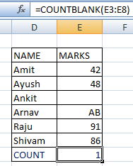
Count: MS Excel
COUNTBLANK()
It will return the count the total number blank cell among all the values selected in any particular row or column
It will include only the blank cell
Select any particular cell where the average will be store
Write the formula for COUNTBLANK () in the formula bar
=COUNTBLANK(first cell column/row : last cell column/row)
In this example it is –
COUNTBLANK(E3:E8) and result is in cell E9

Slide 29
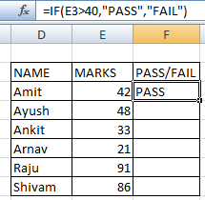
IF: MS Excel
IF()
The IF function runs a logical test and returns one value for a TRUE result, and another for a FALSE result.
For example,
to "pass" scores above 40:
Write the formula for IF () in the formula bar
=IF(E3>40,"Pass","Fail")

Slide 30
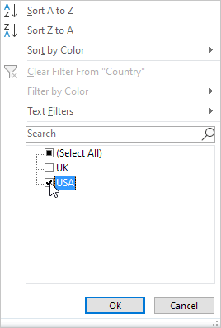
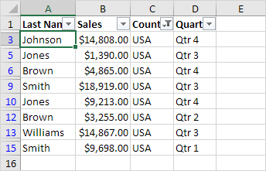
Filter
Click the arrow next to Country.
Click on Select All to clear all the check boxes, and click the check box next to USA.
Click OK
Result. Excel only displays the sales in the USA.

Slide 31
Software process and Process Models
Data Filtering
Filtering data is referred to displaying only the set of data which meet certain condition.
Other data which are not meet the condition should be be gets hide
We can perform this operation using MS Excel
31

Slide 32
Software process and Process Models
VLOOKUP
The VLOOKUP Function in Excel is a tool for looking up a piece of information in a table or data set and extracting some corresponding data/information.
In simple terms, the VLOOKUP function says the following to Excel: “Look for this piece of information (e.g., bananas), in this data set (a table), and tell me some corresponding information about it (e.g., the price of bananas)”.
32

Slide 33
Software process and Process Models
VLOOKUP Formula
=VLOOKUP(lookup_value, table_array, col_index_num, [range_lookup])
Lookup_value (required argument) – Lookup_value specifies the value that we want to look up in the first column of a table.
Table_array (required argument) – The table array is the data array that need to be searched.
33

Slide 34
Software process and Process Models
VLOOKUP Formula
Col_index_num (required argument) – This is an integer, specifying the column number of the supplied table_array, that you want to return a value from.
Range_lookup (optional argument) –The argument can be set to TRUE or FALSE
TRUE – Approximate match, that is, if an exact match is not found, use the closest match below the lookup_value.
FALSE – Exact match, that is, if an exact match not found, then it will return an error.
34

Slide 35
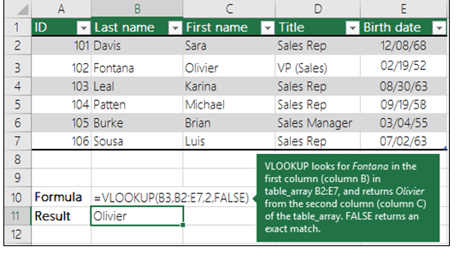
Software process and Process Models
VLOOKUP Example
.
35

Slide 36
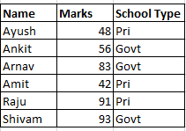
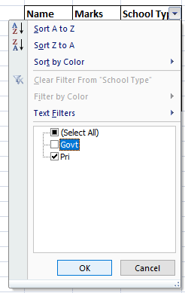

Software process and Process Models
Data Filtering: MS Excel
Steps
Click any single cell inside a data set.
On the Data tab, in the Sort & Filter group, click Filter.
36

Slide 37
Software process and Process Models
Sorting : MS Excel
Sorting
It is the process of arranging data in a ascending or descending order
Select Marks column in the data set
Select the Sort & Filter option
Click sort smallest to largest
37

Slide 38
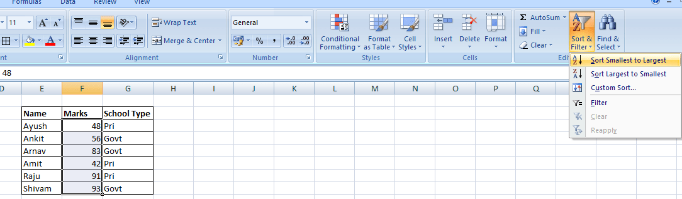
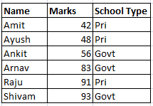
Software process and Process Models
Sorting : MS Excel
Sort on one column
38

Slide 39
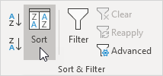
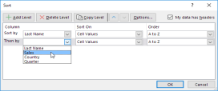
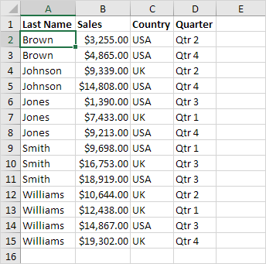
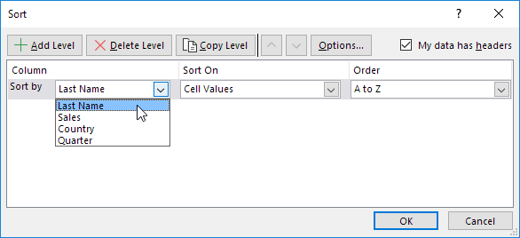
Sort on multiple columns
Basic Data Manipulation (Sorting)
On the Data tab, in the Sort & Filter group, click Sort.
Sorting dialog box appears
Select Last Name from the 'Sort by' drop-down list.
4. Click on Add Level.
5. Select Sales from the 'Then by' drop-down list.
6. Click OK

Slide 40
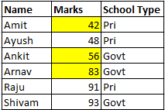
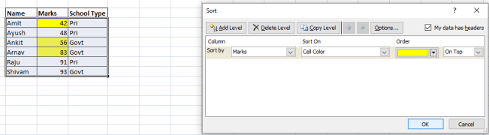
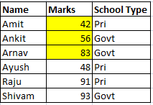
Software process and Process Models
Custom Sorting : MS Excel
40

Slide 41
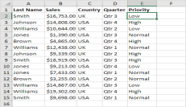
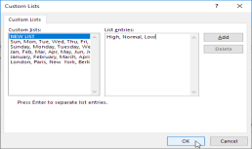
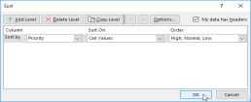
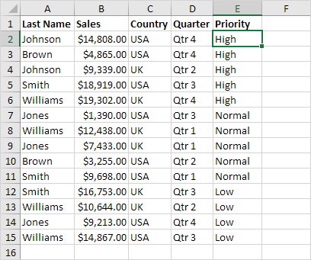
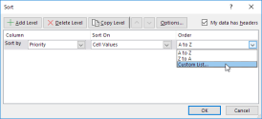
Sort on custom list (Sort by Priority (High, Normal, Low))
Basic Data Manipulation (Sorting)
Click any cell inside the data set.
On the Data tab, in the Sort & Filter group, click Sort.
Select Priority from the 'Sort by' drop-down list.
Select Custom List from the 'Order' drop-down list.
5. Type the list entries and click OK

Slide 42
Installing Data Analysis Tool in Excel
Analysis Tool in Excel

Slide 43
Installing Data Analysis Tool in Excel
Click on the File tab, click Options, and then click the Add-Ins category.
In the Manage box, select Excel Add-ins and then click Go.
In the Add-Ins available box, select the Analysis Tool Pack check box, and then click OK.

Slide 44
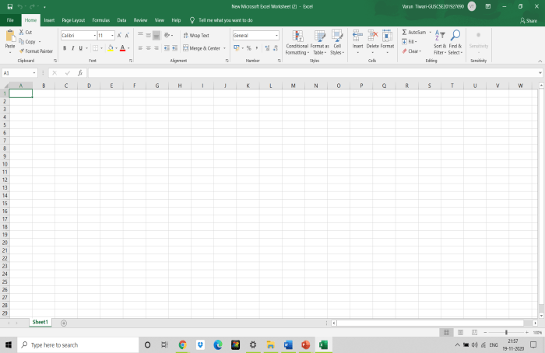
Installing Data Analysis Tool in Excel
Click on the File tab

Slide 45

Installing Data Analysis Tool in Excel
Click on Options

Slide 46
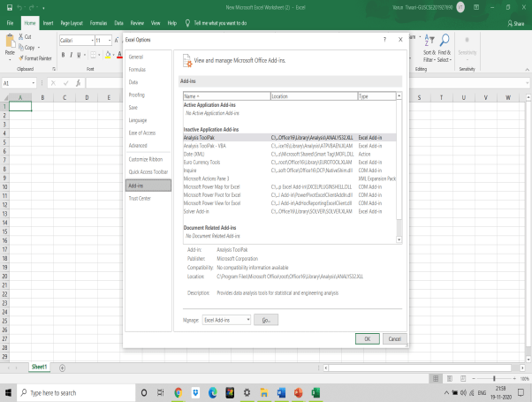
Installing Data Analysis Tool in Excel
Click on the Add-Ins Category

Slide 47
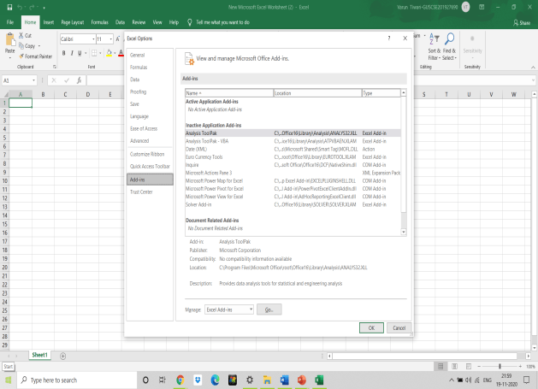
Installing Data Analysis Tool in Excel
In the Manage box, select Excel Add-ins and then click Go.

Slide 48
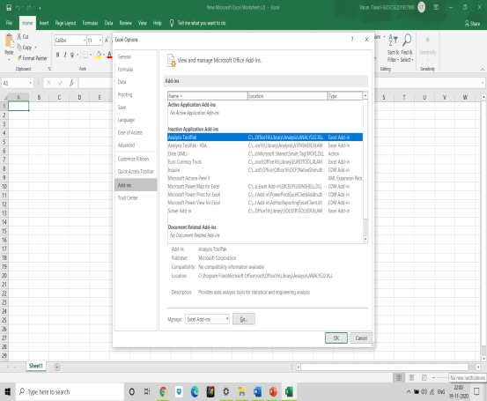
Installing Data Analysis Tool in Excel
In the Add-Ins available box, select the Analysis Tool Pack check box, and then click OK.

Slide 49
Introduction
Descriptive Statistics
Descriptive statistics are used to describe the basic features of the data in a study.
They provide simple summaries about the sample and the measures.
Together with simple graphics analysis, they form the basis of virtually every quantitative analysis of data.

Slide 50
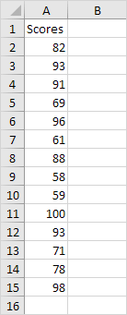
Descriptive Statistics
You can use the Analysis Toolpak add-in to generate descriptive statistics. For example, you may have the scores of 14 participants for a test.

Slide 51
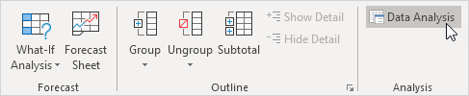
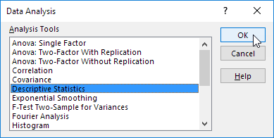
Descriptive Statistics
To generate descriptive statistics for these scores, execute the following steps.
1. On the Data tab, in the Analysis group, click Data Analysis.
2. Select Descriptive Statistics and click OK.

Slide 52
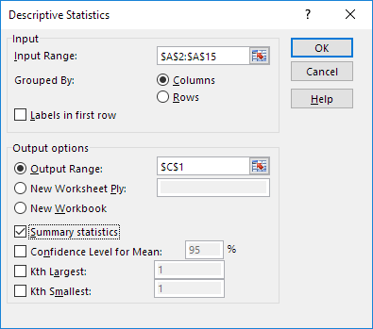
Descriptive Statistics
3. Select the range A2:A15 as the Input Range.
4. Select cell C1 as the Output Range.
5. Make sure Summary statistics is checked.
6. Click OK.

Slide 53
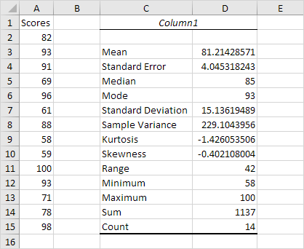
Descriptive Statistics
Result:

Slide 54
np.mean(arr)
Descriptive analysis using Python
mean()- takes a NumPy array as an argument and returns the arithmetic mean of the data.
np.mean(arr)
median()- takes a NumPy array as an argument and returns the median of the data.
np.median(arr)
import numpy as np
arr = np.array([4, 5, 8, 5, 6, 4, 9, 2, 4, 3, 6])
# measures of central tendency
mean = np.mean(arr)
median = np.median(arr)
print("Array =", arr)
print("Mean =", mean)
print("Median =", median)

Slide 55
np.mean(arr)
Descriptive analysis using Python
Like NumPy module, the statistics module also contains statistical functions like mean , median , mode….etc .
So let us see an example of a mode using the statistics module.
import statistics as st
import numpy as np
# create an 1 d array
arr1 = np.array([9, 8, 7, 6, 6, 6, 6, 5, 5, 4,
3, 2, 1, 1, 1, 1, 1, 1])
# display the mode
print(st.mode(arr1))

Slide 56
np.mean(arr)
Measures of dispersion using Python
amin()- it takes a NumPy array as an argument and returns the minimum.
np.amin(arr)
amax()- it takes a NumPy array as an argument and returns maximum.
np.amax(arr)
ptp()- it takes a NumPy array as an argument and returns the range of the data.
np.ptp(arr)
var()- it takes a NumPy array as an argument and returns the variance of the data.
np.var(arr)
std()- it takes a NumPy array as an argument and returns the standard variation of the data.
np.std(arr)

Slide 57
np.mean(arr)
Measures of dispersion using Python
import numpy as np
arr = np.array([4, 5, 8, 5, 6, 4,9, 2, 4, 3, 6])
# measures of dispersion
min = np.amin(arr)
max = np.amax(arr)
range = np.ptp(arr)
variance = np.var(arr)
sd = np.std(arr)
print("Array =", arr)
print("Measures of Dispersion")
print("Minimum =", min)
print("Maximum =", max)
print("Range =", range)
print("Variance =", variance)
print("Standard Deviation =", sd)

Slide 58
Introduction
Histogram
A histogram is the graphical representation of data where data is grouped into continuous number ranges and each range corresponds to a vertical bar.
The horizontal axis displays the number range.
The vertical axis (frequency) represents the amount of data that is present in each range.

Slide 59


Example
Histogram
Uncle Bruno owns a garden with 30 black cherry trees. Each tree is of a different height. The height of the trees (in inches): 61, 63, 64, 66, 68, 69, 71, 71.5, 72, 72.5, 73, 73.5, 74, 74.5, 76, 76.2, 76.5, 77, 77.5, 78, 78.5, 79, 79.2, 80, 81, 82, 83, 84, 85, 87.

Slide 60





Types
Bell-Shaped Histogram
Bimodal Histogram
skewed right Histogram
skewed left Histogram
Uniform Histogram

Slide 61

Histogram
1. First, enter the bin numbers (upper levels) in the range C4:C8.

Slide 62

Histogram
2. On the Data tab, in the Analysis group, click Data Analysis.
3. Select Histogram and click OK.

Slide 63

Histogram
4. Select the range A2:A19.
5. Click in the Bin Range box and select the range C4:C8.
6. Click the Output Range option button, click in the Output Range box and select cell F3.
7. Check Chart Output.
8. Click OK.

Slide 64

Histogram
9. Click the legend on the right side and press Delete.
10. Properly label your bins.
11. To remove the space between the bars, right click a bar, click Format Data Series and change the Gap Width to 0%.
12. To add borders, right click a bar, click Format Data Series, click the Fill & Line icon, click Border and select a color.

Slide 65

Histogram
Result:

Slide 66

Histogram – Using Python
# import libraries
from matplotlib import pyplot as plt
import numpy as np
# Creating dataset
a = np.random.randint(100, size =(50))
# Creating plot
fig = plt.figure(figsize =(10, 7))
plt.hist(a, bins = [0, 10, 20, 30,40, 50, 60, 70,80, 90, 100])
plt.title("Numpy Histogram")
# show plot
plt.show()

Slide 67
Introduction
Correlation
It is a statistical-based, and thus, mathematics-based information analysis technique.
It consists of analysing the relationship between at least two variables, e.g. two fields of a database or of a log or raw data.
To analyse the relationship between variables, “correlation coefficients” are used.

Slide 68

Correlation
The correlation coefficient (a value between -1 and +1) tells you how strongly two variables are related to each other. We can use the CORREL function or the Analysis Toolpak add-in in Excel to find the correlation coefficient between two variables.
A correlation coefficient of +1 indicates a perfect positive correlation. As variable X increases, variable Y increases. As variable X decreases, variable Y decreases.

Slide 69

Correlation
- A correlation coefficient of -1 indicates a perfect negative correlation. As variable X increases, variable Z decreases. As variable X decreases, variable Z increases.
- A correlation coefficient near 0 indicates no correlation.

Slide 70

Correlation
To use the Analysis Toolpak add-in in Excel to quickly generate correlation coefficients between multiple variables, execute the following steps.
1. On the Data tab, in the Analysis group, click Data Analysis.
2. Select Correlation and click OK.

Slide 71

Correlation
3. For example, select the range A1:C6 as the Input Range.

Slide 72


Correlation
4. Check Labels in first row.
5. Select cell A8 as the Output Range.
6. Click OK.
Result

Slide 73

Correlation coefficient
The correlation coefficient that indicates the strength of the relationship between two variables
can be found using the following formula:
r_{xy} – the correlation coefficient of the linear relationship between the variables x and y
x_{i} – the values of the x-variable in a sample
x̅ – the mean of the values of the x-variable
y_{i} – the values of the y-variable in a sample
ȳ – the mean of the values of the y-variable

Slide 74
Correlation coefficient
The correlation coefficient is a value that indicates the strength of the relationship between variables. The coefficient can take any values from -1 to 1. The interpretations of the values are:
-1: Perfect negative correlation. The variables tend to move in opposite directions (i.e., when one variable increases, the other variable decreases).
0: No correlation. The variables do not have a relationship with each other.
1: Perfect positive correlation. The variables tend to move in the same direction (i.e., when one variable increases, the other variable also increases).

Slide 75
Correlation implementing python
import numpy as np
x = [11, 2, 7, 4, 15, 6, 10, 8, 9, 1, 11, 5, 13, 6, 15]
y = [2, 5, 17, 6, 10, 8, 13, 4, 6, 9, 11, 2, 5, 4, 7]
# to return the upper three quartiles
pearsons_coefficient = np.corrcoef(x, y)
print("The pearson's coeffient of the x and y inputs are: \n" ,pearsons_coefficient)

Slide 76
Introduction
Moving Average
In statistics, a moving average (rolling average or running average) is a calculation to analyze data points by creating a series of averages of different subsets of the full data set.
It is also called a moving mean (MM) or rolling mean and is a type of finite impulse response filter.

Slide 77

Moving Average
This example teaches you how to calculate the moving average of a time series in Excel. A moving average is used to smooth out irregularities (peaks and valleys) to easily recognize trends.
1. First, let's take a look at our time series.

Slide 78

Moving Average
2. On the Data tab, in the Analysis group, click Data Analysis.
3. Select Moving Average and click OK.

Slide 79

Moving Average
4. Click in the Input Range box and select the range B2:M2.
5. Click in the Interval box and type 6.
6. Click in the Output Range box and select cell B3.
7. Click OK.

Slide 80

Moving Average
8. Plot a graph of these values.
Explanation: because we set the interval to 6, the moving average is the average of the previous 5 data points and the current data point. As a result, peaks and valleys are smoothed out. The graph shows an increasing trend. Excel cannot calculate the moving average for the first 5 data points because there are not enough previous data points.

Slide 81

Moving Average
9. Repeat steps 2 to 8 for interval = 2 and interval = 4.
Conclusion: The larger the interval, the more the peaks and valleys are smoothed out. The smaller the interval, the closer the moving averages are to the actual data points.

Slide 82
Moving Average python implementation
import numpy as np
arr = [1, 2, 3, 7, 9]
window_size = 3
i = 0
# Initialize an empty list to store moving averages
moving_averages = []
#consider every window of size 3
while i < len(arr) - window_size + 1:
# Calculate the average of current window
window_average = round(np.sum(arr[
i:i+window_size]) / window_size, 2)
# Store the average of current
# window in moving average list
moving_averages.append(window_average)
# Shift window to right by one position
i += 1
print(moving_averages)

Slide 83
Numerical Example
5 year Simple Moving Average forecastCalculate 5 year Simple Moving Average forecast
year | 1 | 2 | 3 | 4 | 5 | 6 | 7 | 8 | 9 | 10 | 11 | 12
Sales | 5.2 | 4.9 | 5.5 | 4.9 | 5.2 | 5.7 | 5.4 | 5.8 | 5.9 | 6 | 5.2 | 4.8
(1) year | (2) Sales | (3) 5 year moving total | (4) 5 year moving average (3)÷5
1 | 5.2
2 | 4.9
3 | 5.5 | 5.2+4.9+5.5+4.9+5.2=25.7 | 25.7÷5=5.14
4 | 4.9 | 4.9+5.5+4.9+5.2+5.7=26.2 | 26.2÷5=5.24
5 | 5.2 | 5.5+4.9+5.2+5.7+5.4=26.7 | 26.7÷5=5.34
6 | 5.7 | 4.9+5.2+5.7+5.4+5.8=27 | 27÷5=5.4
7 | 5.4 | 5.2+5.7+5.4+5.8+5.9=28 | 28÷5=5.6
8 | 5.8 | 5.7+5.4+5.8+5.9+6=28.8 | 28.8÷5=5.76
9 | 5.9 | 5.4+5.8+5.9+6+5.2=28.3 | 28.3÷5=5.66
10 | 6 | 5.8+5.9+6+5.2+4.8=27.7 | 27.7÷5=5.54
11 | 5.2
12 | 4.8
alculation of 5 year moving averages of the data

Slide 84
Introduction
Exponential Smoothing
Exponential smoothing of time series data assigns exponentially decreasing weights for newest to oldest observations.
In other words, the older the data, the less priority (“weight”) the data is given; newer data is seen as more relevant and is assigned more weight.

Slide 85

Exponential Smoothing
This example teaches you how to apply exponential smoothing to a time series in Excel. Exponential smoothing is used to smooth out irregularities (peaks and valleys) to easily recognize trends.
1. First, let's take a look at our time series.

Slide 86

Exponential Smoothing
2. On the Data tab, in the Analysis group, click Data Analysis.
3. Select Exponential Smoothing and click OK.

Slide 87

Exponential Smoothing
4. Click in the Input Range box and select the range B2:M2.
5. Click in the Damping factor box and type 0.9. Literature often talks about the smoothing constant α (alpha). The value (1- α) is called the damping factor.
6. Click in the Output Range box and select cell B3.
7. Click OK.

Slide 88

Exponential Smoothing
8. Plot a graph of these values.
Explanation: because we set alpha to 0.1, the previous data point is given a relatively small weight while the previous smoothed value is given a large weight (i.e. 0.9). As a result, peaks and valleys are smoothed out. The graph shows an increasing trend. Excel cannot calculate the smoothed value for the first data point because there is no previous data point. The smoothed value for the second data point equals the previous data point.

Slide 89

Exponential Smoothing
9. Repeat steps 2 to 8 for alpha = 0.3 and alpha = 0.8.
Conclusion: The smaller alpha (larger the damping factor), the more the peaks and valleys are smoothed out. The larger alpha (smaller the damping factor), the closer the smoothed values are to the actual data points.

